Slide 1

Matrix Factorization
& Two Tower
Dr Seungmin Jin sedzhin@hse.ru
HSE

Slide 2
Course Objectives
Explain why sparse ratings can make similarity-based recommendations unreliable.
Understand how matrix factorization represents users and items as embeddings.
Calculate dot products to score user–item matches.
Distinguish recommendation-oriented matrix factorization from classical SVD.
Explain how two-tower models generate embeddings for scalable candidate retrieval.

Slide 3
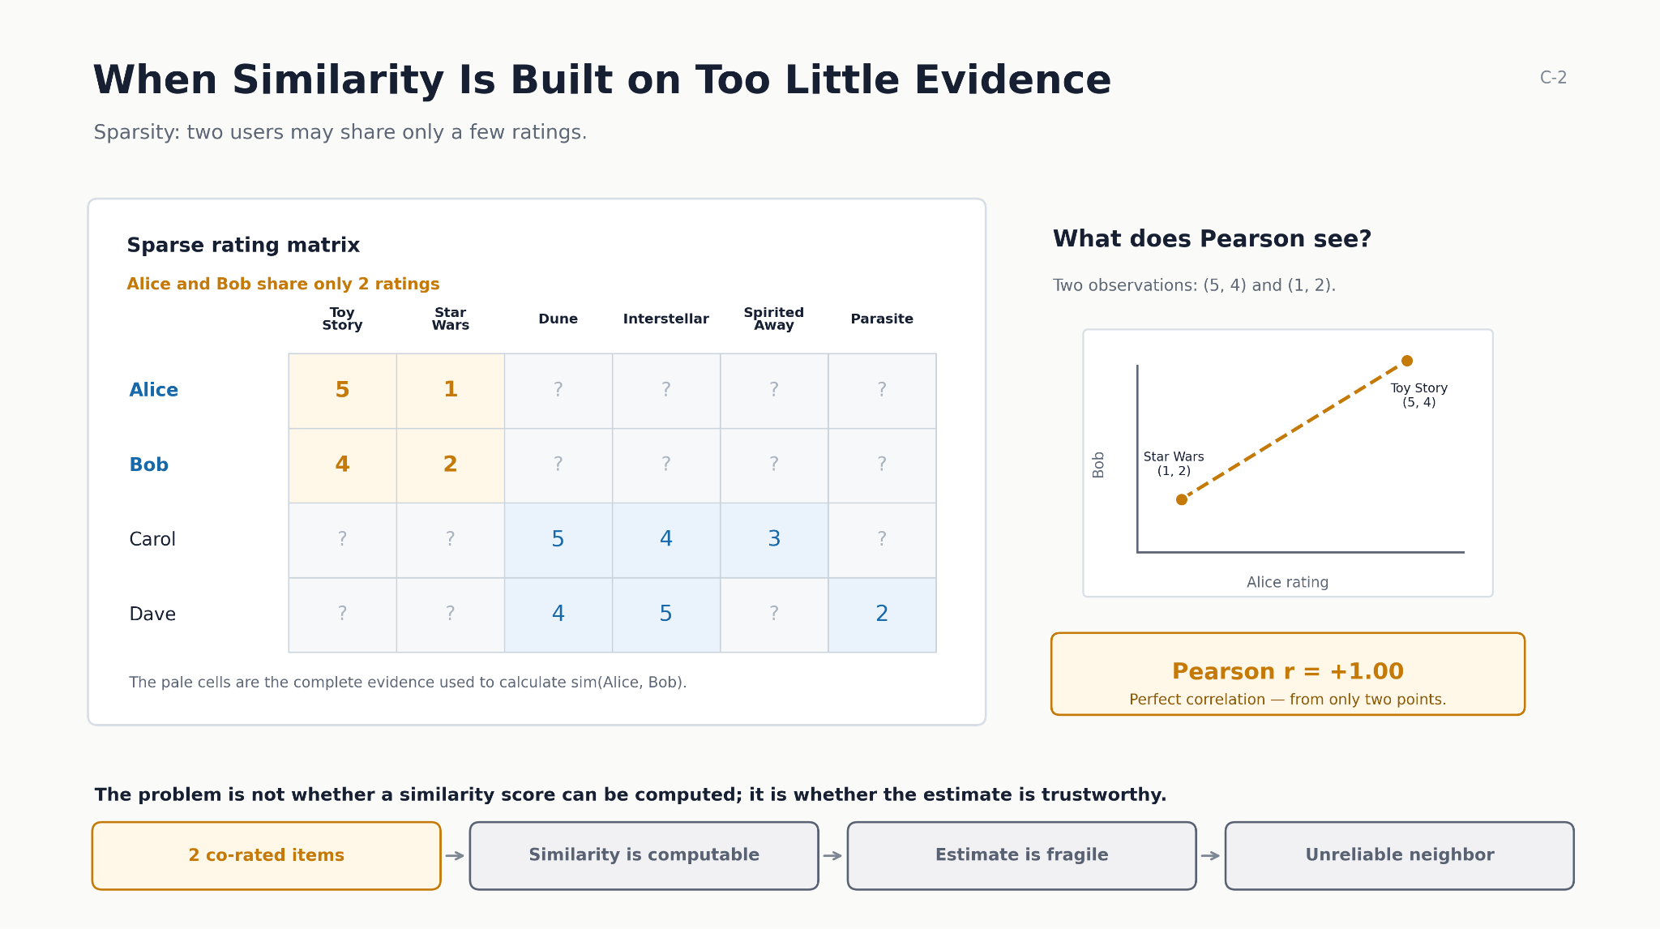

Slide 4
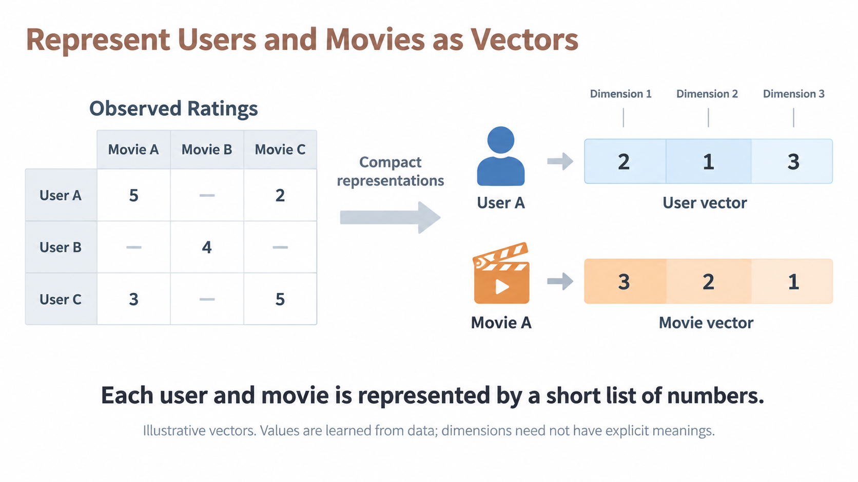

Slide 5
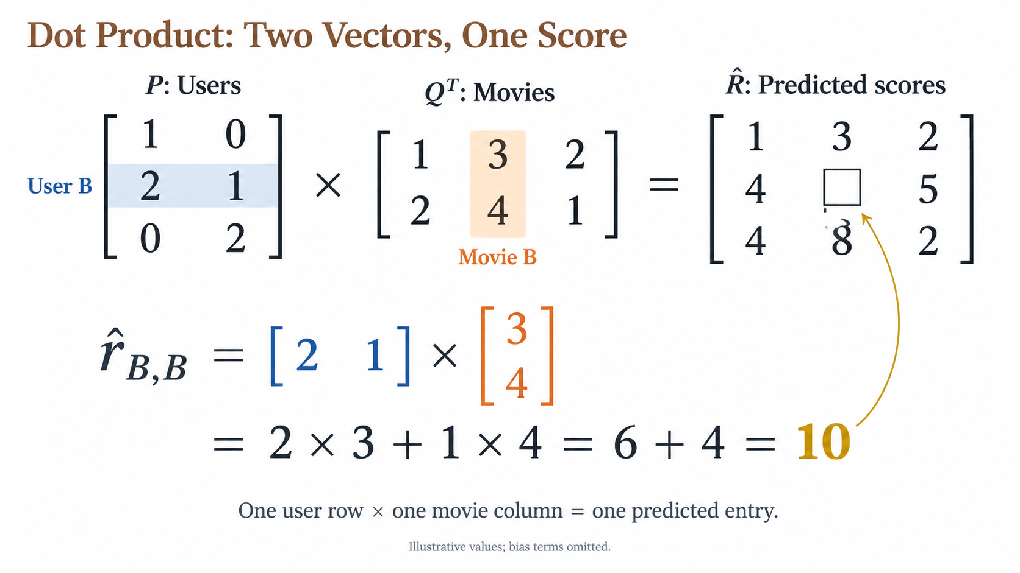

Slide 6
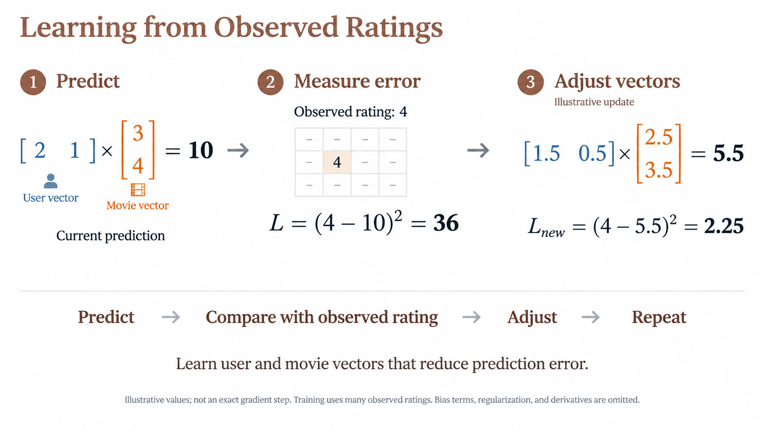

Slide 7
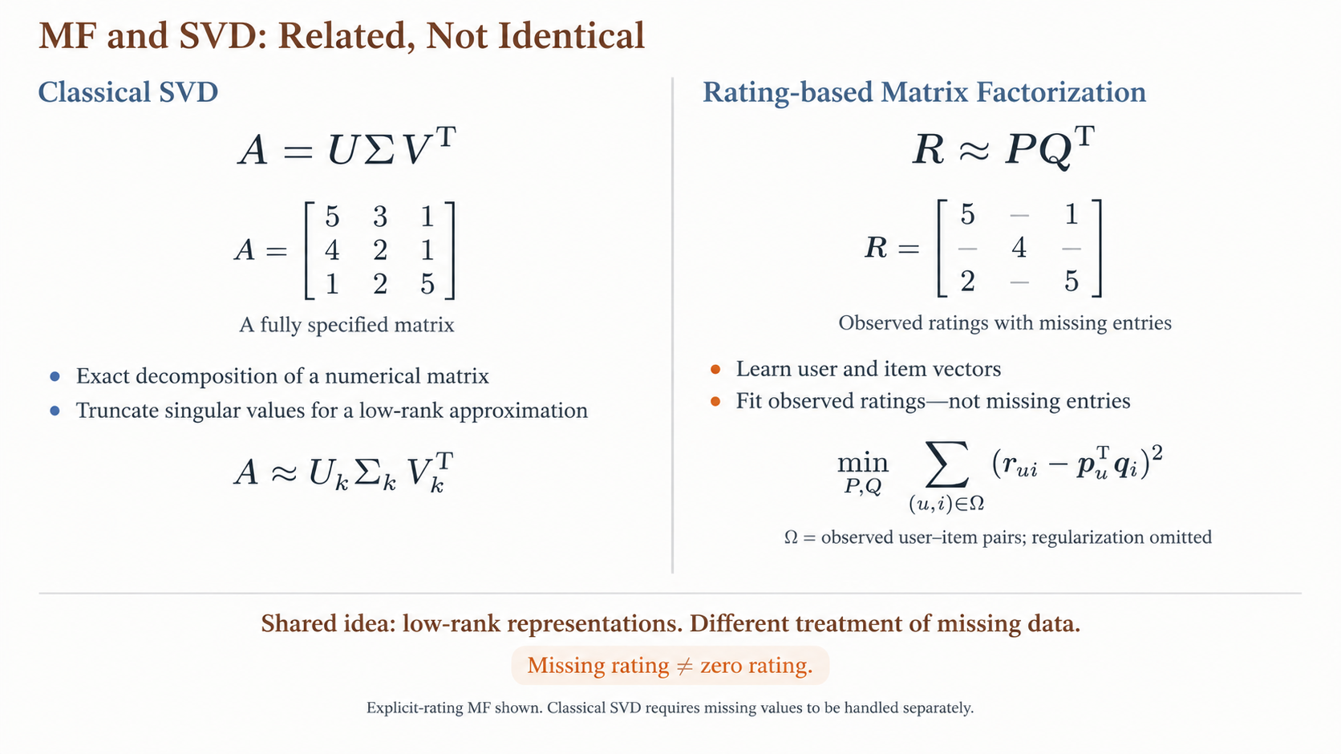

Slide 8
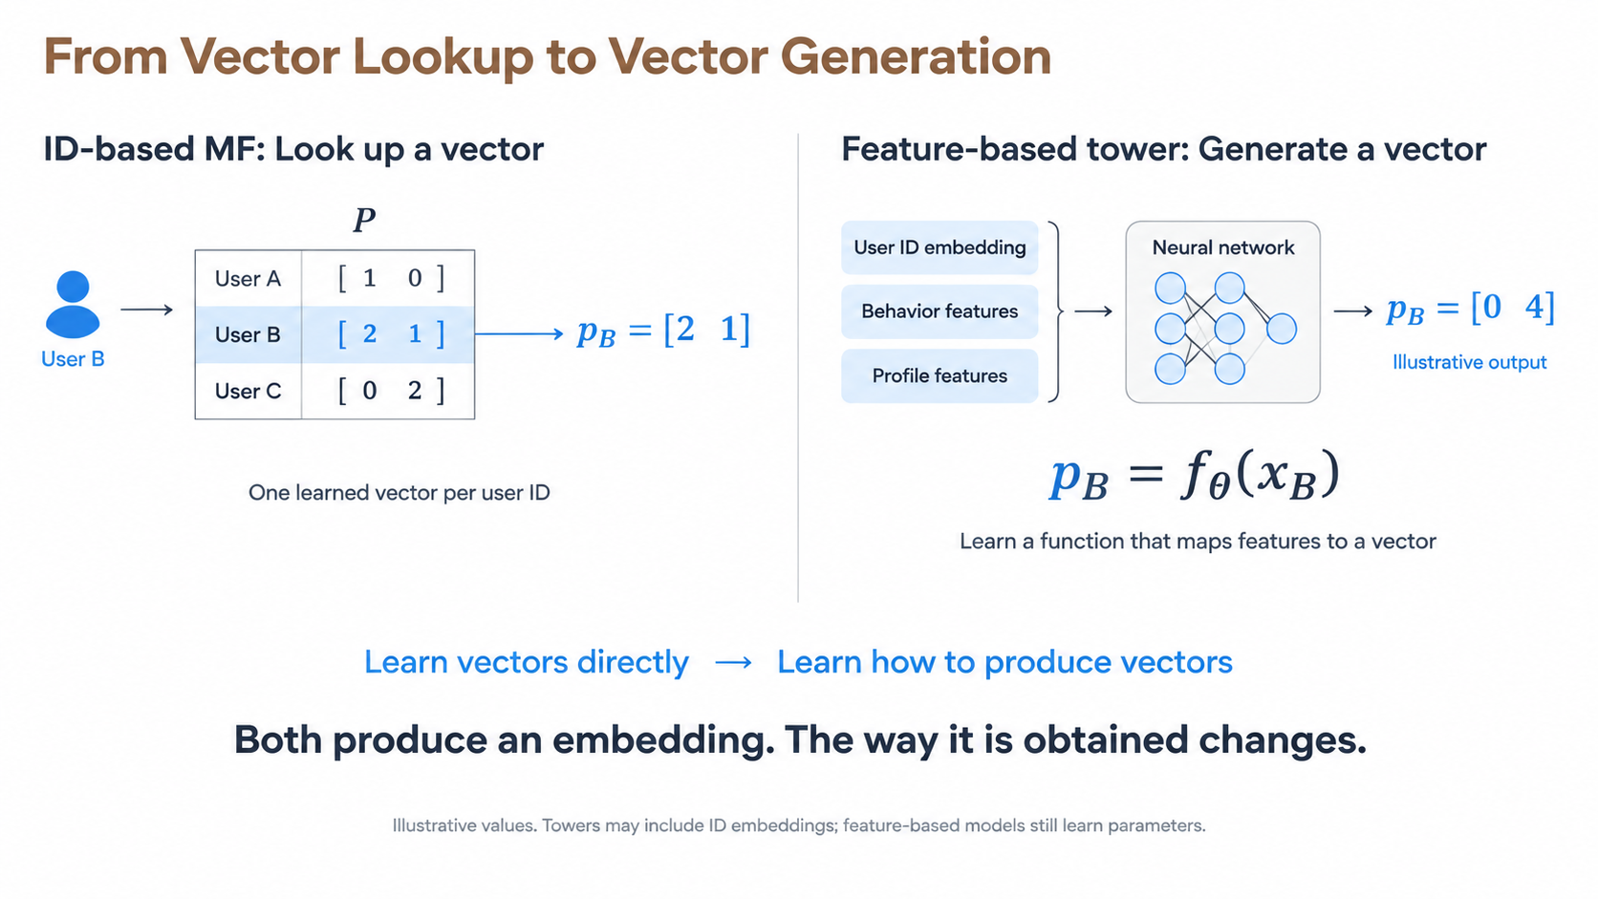

Slide 9
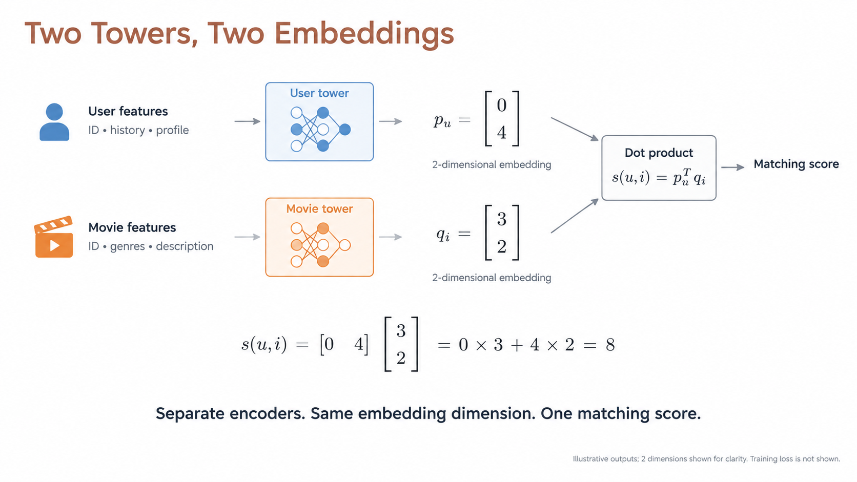

Slide 10
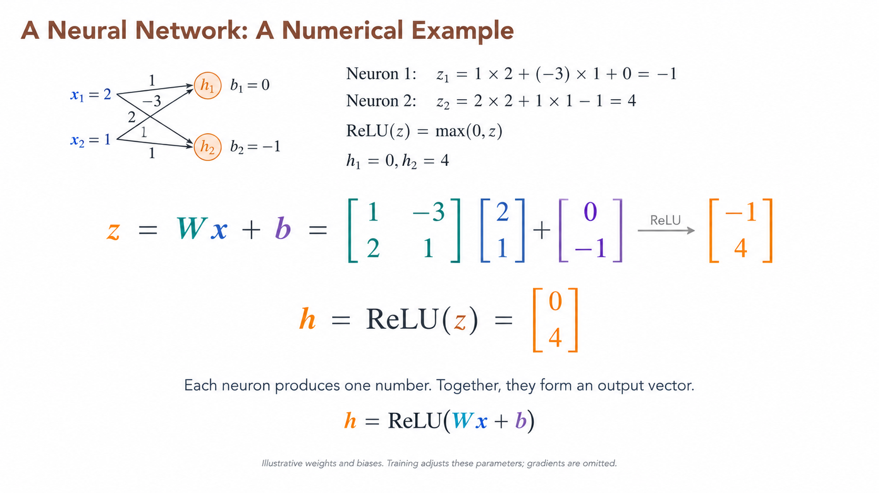
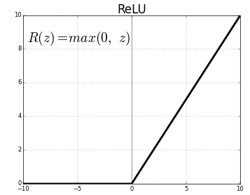
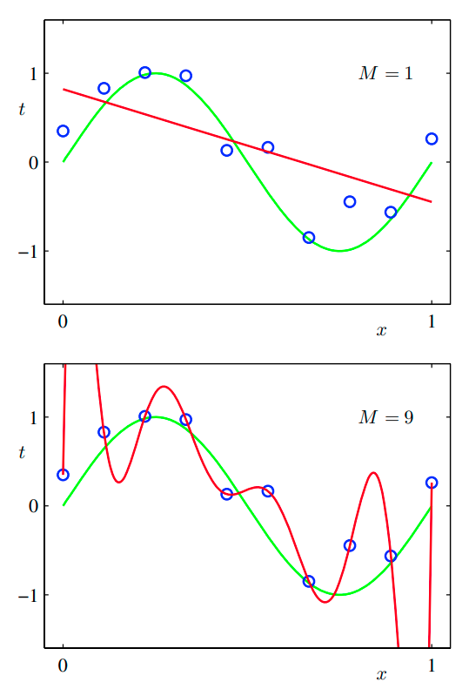

Slide 11
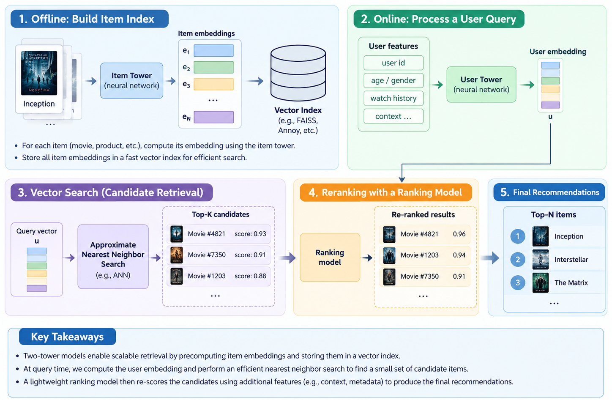
Retrieve Candidates at Scale

Slide 12
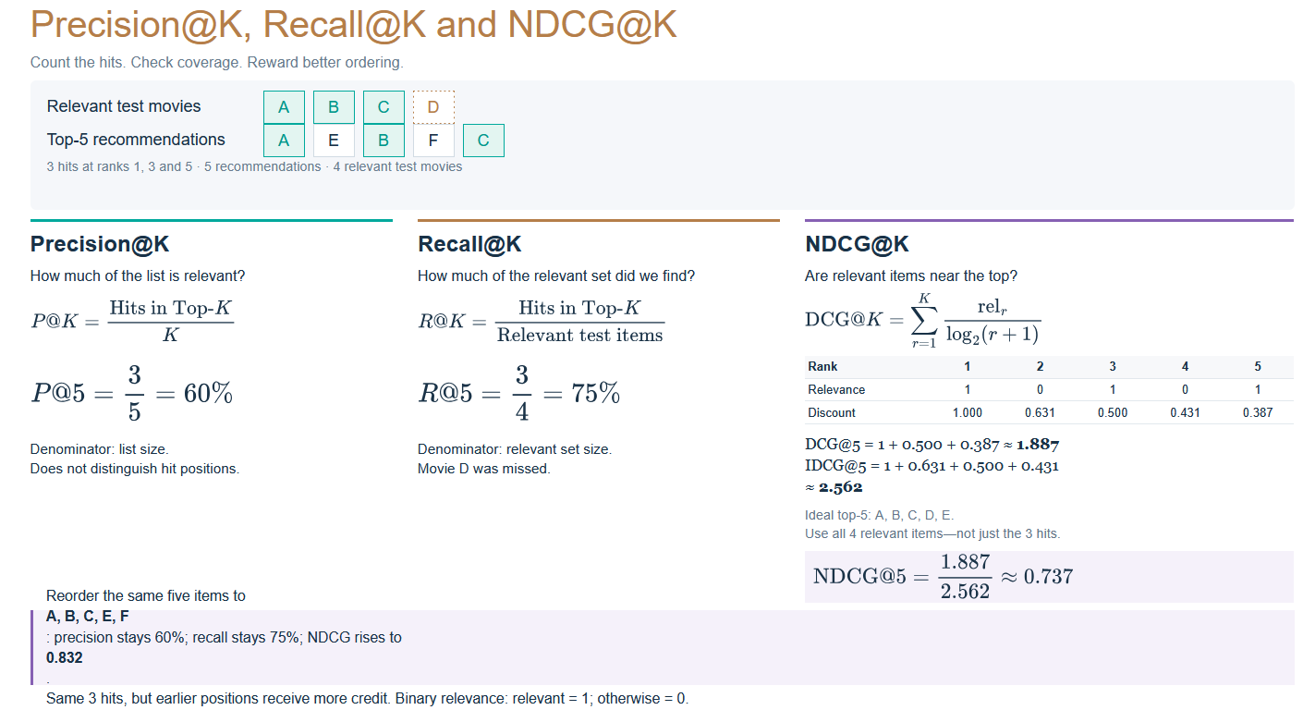

Slide 13
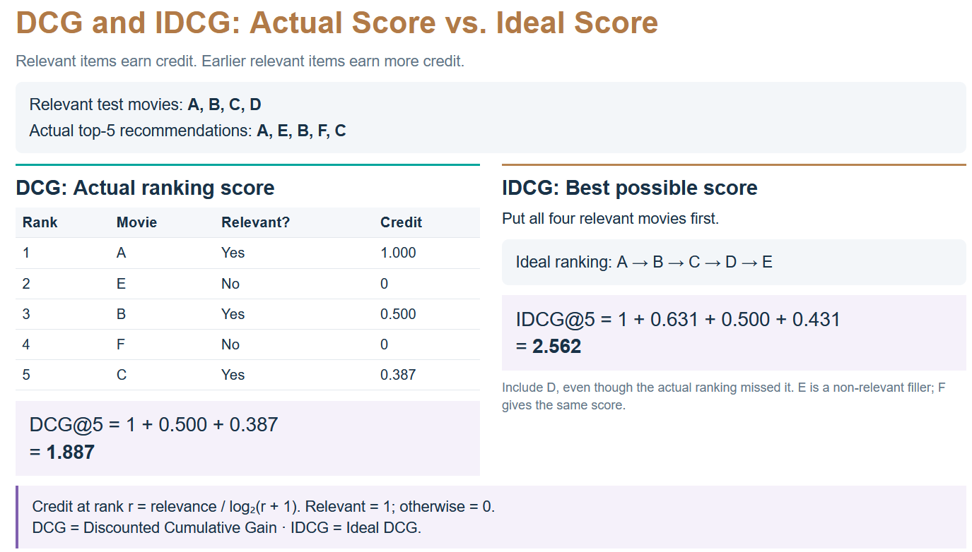

Slide 14
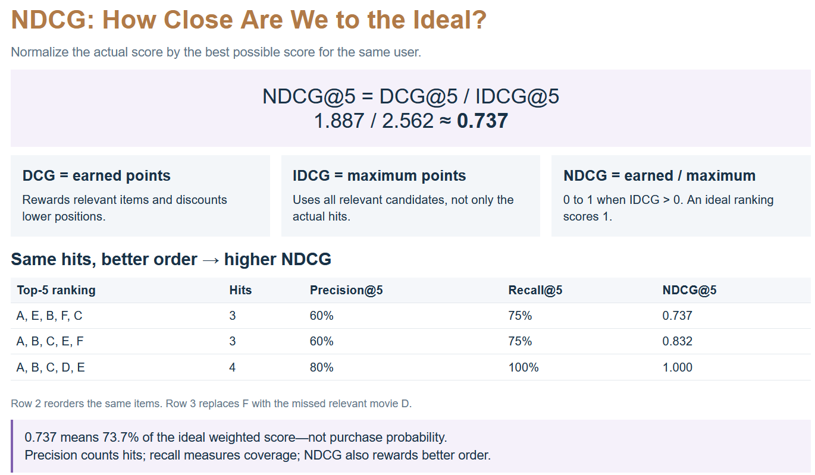
Normalized Discounted Cumulative Gain (NDCG) explained

Slide 15
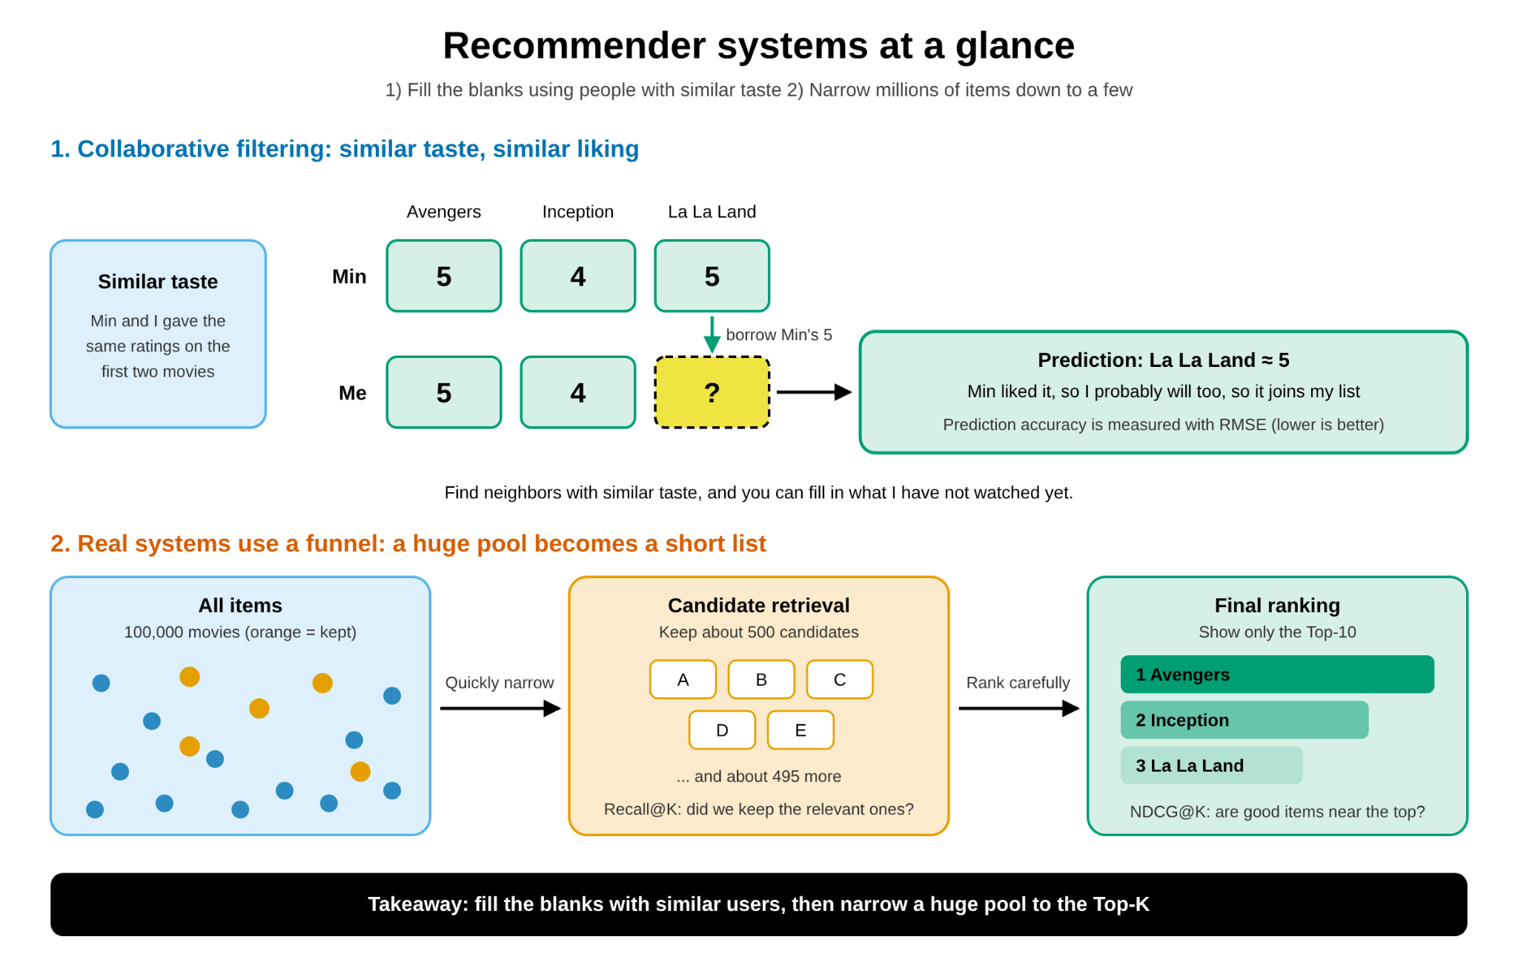

Slide 16
Discussion

Slide 17


TensorFlow.js
TensorFlow.js | Machine Learning for JavaScript Developers

Slide 18
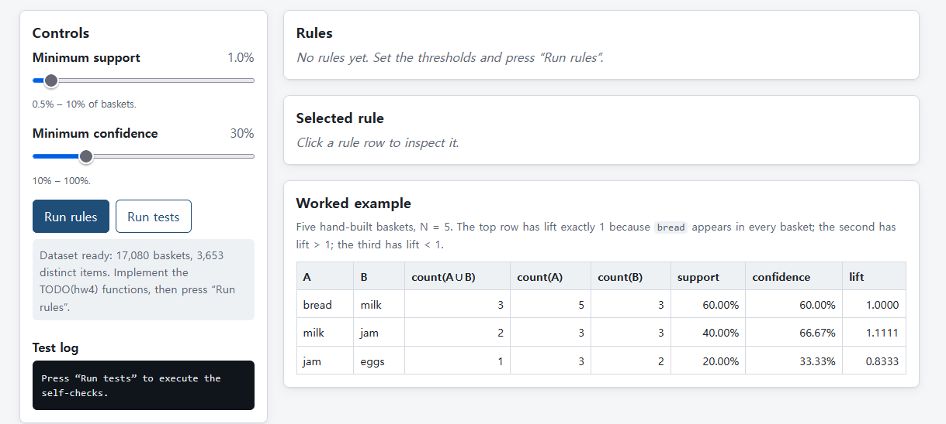
HW4. Association Rules
1. Implementation Task
Repository: dryjins/RecSys-LLMs/tree/main/week4
Dataset: UCI Online Retail dataset. Treat each InvoiceNo as one transaction; use StockCode to identify items and Description to label them.
Basket Construction: Create an invoice–item basket matrix.
Association Rule Mining: Use Apriori or FP-Growth to identify frequent itemsets and generate association rules.
Rule Evaluation: Report support, confidence, and lift for the selected rules.
Rule Filtering: State and justify your minimum support and confidence thresholds; retain rules with lift > 1 for further analysis.
2. Business & Algorithmic Analysis
(Mandatory) Useful vs. Misleading Rules: Present one rule worth investigating and one rule to reject. Justify both using transaction counts, support, confidence, and lift.
(Below Optional)
Rule Direction: Compare A → B with B → A. Explain why their confidence values can differ.
Threshold Trade-off: Explain how changing minimum support or confidence affects the number and usefulness of discovered rules.
Validation Before Action: Check whether a selected rule remains stable in a later time period. Propose a controlled cross-sell, bundle, or product-placement experiment.
Association ≠ Causation: Explain why high lift alone does not prove that an intervention will increase sales.

Slide 19
HW5. From Ratings to Recommendations
1. Implementation Task
Repository: dryjins/RecSys-LLMs/tree/main/week5
Dataset: MovieLens 100K; use week5/u.data for user–movie ratings and week5/u.item for movie titles and genre indicators.1453
Implementation: Build a JavaScript-based application to train and evaluate matrix factorization.
Data Preparation: Report users, movies, ratings, and matrix sparsity. Treat missing ratings as unobserved, not zeros.
Data Split: Sort each user’s ratings by timestamp; use 80% for training, 10% for validation, and 10% for testing. Report exclusions of users or movies absent from training.
Baseline: Predict ratings using the training-set mean.
Matrix Factorization: Learn 16-dimensional user and movie vectors; predict ratings using their dot product.
Training: Minimize squared error on observed training ratings. Select the checkpoint using validation RMSE; report baseline and MF test RMSE.
Recommendations: Produce Top-10 lists for two test users, showing movie titles and scores. Exclude movies rated in training or validation.
Evaluation: Treat test ratings ≥ 4.0 as relevant. Report average Recall@10 over users with eligible relevant test movies, using all training-set movies as candidates.
2. Business & Algorithmic Analysis
Familiar Choices vs. New Discoveries: Do your recommendations help users discover movies, or mainly repeat their existing preferences? Compare two users’ Top-10 lists with their past ratings. Use specific movies or genres to discuss familiar choices, new discoveries, and their value for a streaming platform.
https://dryjins.github.io/RecSys-LLMs/week5/

